Slide 1
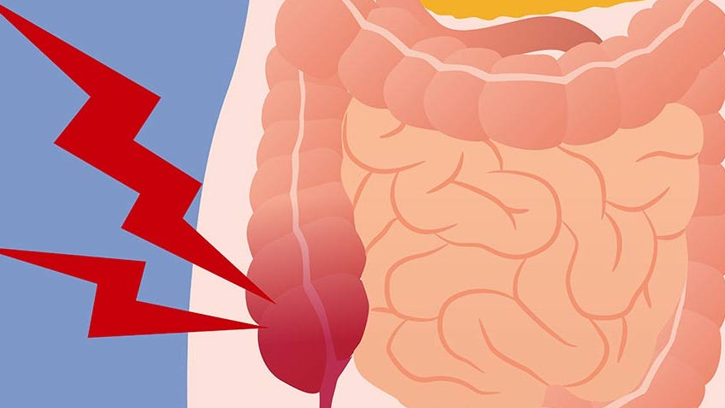
appendicitis
Chrissy McCain MSN, RN
Spring 2025

Slide 2
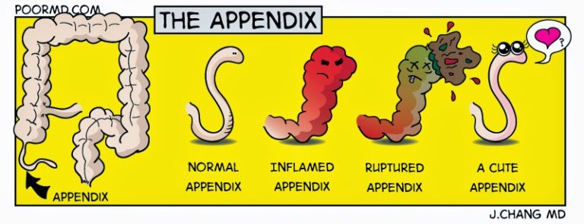

Slide 3
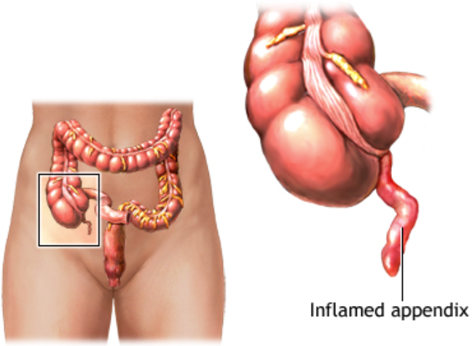
What is the appendix?
Located where the small intestine meets the large intestine in the lower right quadrant
Many theories are out there about it’s function, but there is no clear reason for its existence.

Slide 4
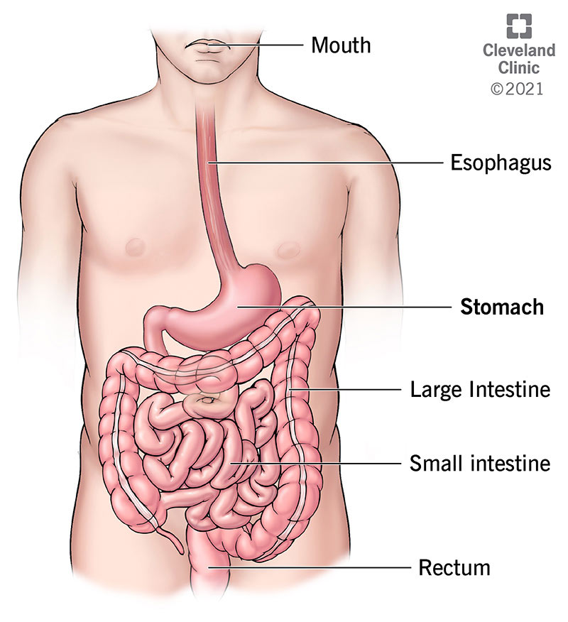
GI Anatomy
Stomach to small intestine
Small intestine to large intestine
Appendix sits on large intestine just after the intersection of the two

Slide 5
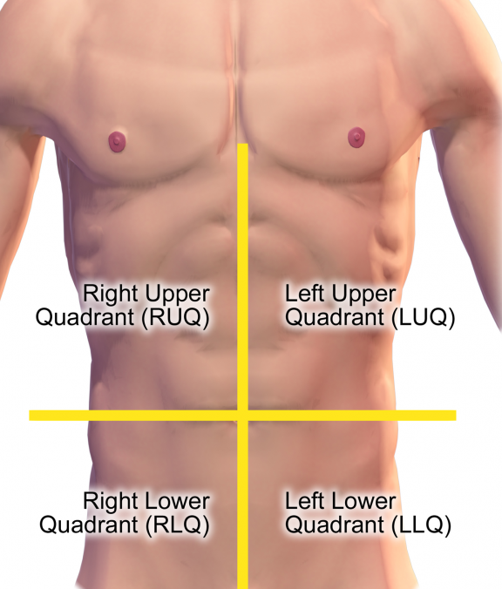
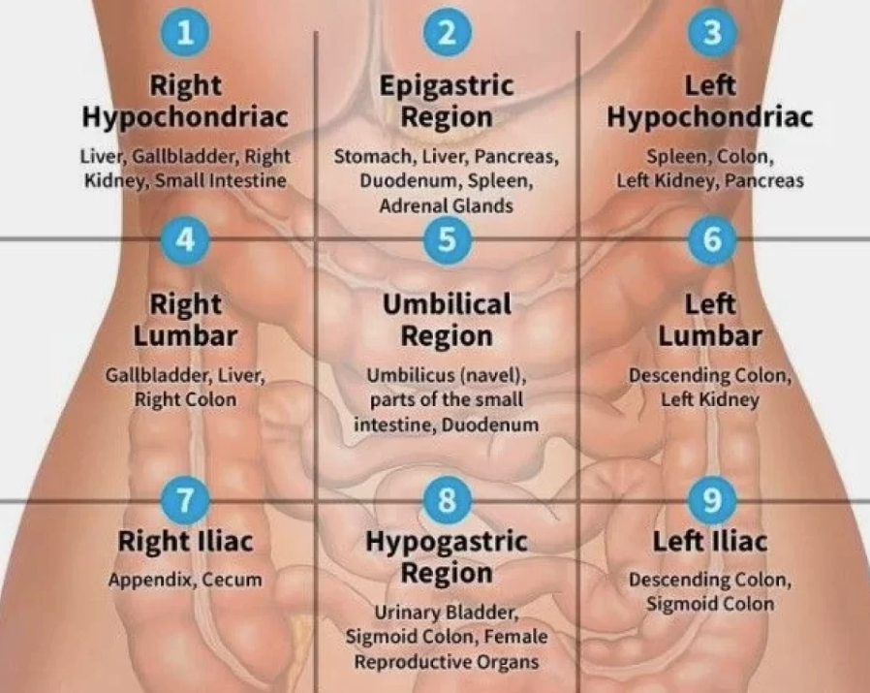
Gi assessment
4 Quadrants (Minimum Assessment)
9 Areas for Assessment – Notice #7 ☺

Slide 6
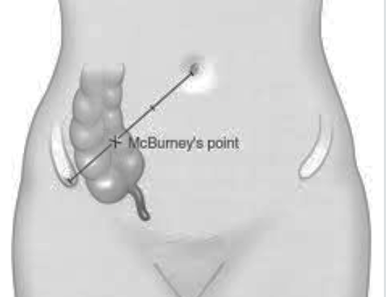
Signs & symptoms
Classic symptoms:
  Abdominal pain* & guarding
  Nausea & Vomiting
  Fever
Loss of appetite
Elevated WBC
Abdominal Pain – Rebound tenderness at McBurney’s point

Slide 7
appendicitis
Inflammation of the appendix
Caused by obstruction of fecal matter
If untreated,
May rupture causing peritonitis
Potential widespread infection
Could lead to sepsis

Slide 8

diagnostics
Physical Assessment –
  Palpation of abdomen to identify pain, rebound tenderness
Imaging –
  Ultrasound: More common for children and pregnant women
  CT Scan: Gold standard for diagnosing appendicitis in adults
Lab work –
  Elevated WBCs indicating infection

Slide 9
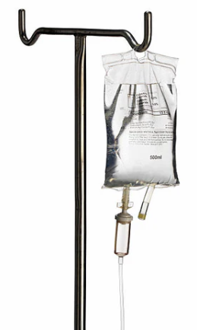
Nursing interventions
Preoperative care:
  Assess pain & treat with analgesics
  Keep patient NPO in prep for surgery
  Administer IVF & IV antibiotics as ordered
  Ensure consent form is completed & in chart
  Monitor for signs & symptoms of rupture (momentary relief & then increased pain)
  Ensure lab work is completed and in chart for day of surgery
  Report any abnormal labs
***Medical orders to be completed “as ordered”

Slide 10
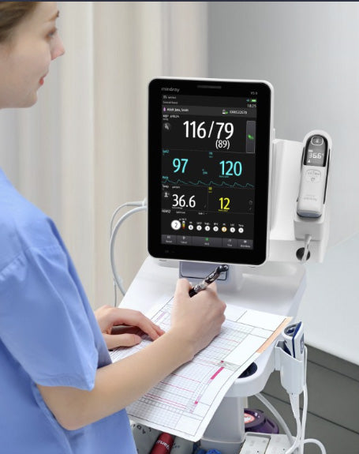
Nursing interventions
Postoperative care:
  Monitor frequent vital signs
  Manage pain
  Encourage deep breathing & early ambulation
  Administer IVF & IV antibiotics as ordered
  Surgical site care & monitoring for S&S of infection
  Drain management
  Report any abnormal new/worsening symptoms to provider
***Medical orders to be completed “as ordered”

